Slide 1
MLA 1: In-Text Citation and Works Cited

Slide 2
This workshop will cover
MLA Document Format
In-Text Citation
Works Cited Page

Slide 3

What is MLA?
MLA stands for Modern Language Association, which is a professional association for scholars of language and literature.
The MLA sets guidelines for proper formatting and citation style.
Most classes in the Humanities, like English, will use MLA formatting.

Slide 4
Why do we use MLA?
Avoid plagiarism: Using MLA citation techniques properly ensures that you will not have plagiarized material in your assignment.
Build credibility: By using MLA citation and formatting correctly, you show that you can meet academic standards. Your readers are more likely to accept your assertions if they appear in an academically-correct format.
Be part of a scholarly community: When citing in MLA style, you provide your readers with valuable information about your source material. As fellow scholars, they may choose to learn more about the information you provide. Your Works Cited page will become their guide to finding that material.

Slide 5
Resources
Refer to these sources when working on your MLA formatting:
Handbooks like Rules for Writers
Textbooks, which may include info on MLA (check the appendices)
The TLC, where you can get a handout or work with a tutor
Online
College of the Canyons Library
Purdue OWL
Cornell University Library

Slide 6
Document Format

Slide 7
Formatting Requirements
Some MLA formatting requirements apply to the entire document. These are:
Margins: One inch on all four sides
Spacing: Use double spacing throughout the entire document. Do not add extra spaces between paragraphs or sections
Font: 12 point professional font (Times New Roman or Calibri)
Header: Your last name and page number should appear on every page

Slide 8
Formatting the First Page
Heading: In the top left corner, include the following:
Your Name
Instructor’s Name
Class
Date
Title: Include the title in the center of the page. Do not use italics, bold, underline, or increase the font of the title.
Spacing: Do not add extra spaces between the heading and title, or between the title and text.

Slide 9
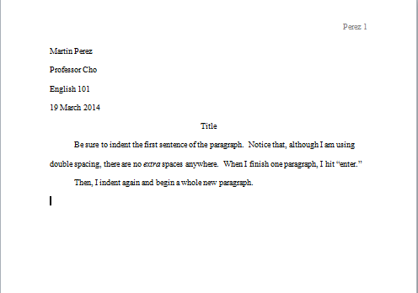
Sample first page

Slide 10
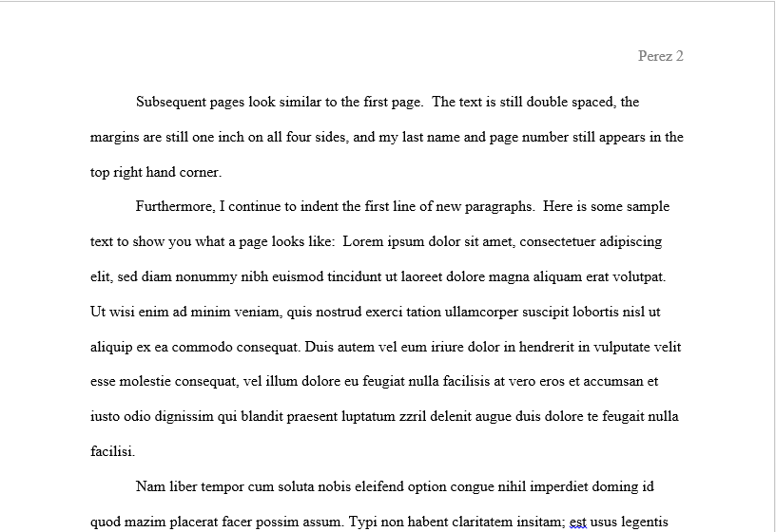
Sample Later Page

Slide 11

Not sure how to set up the page using Microsoft word?
Watch this video to learn!

Slide 12
One more formatting note: Italics and quotation marks
When discussing an author’s text, the title may be in italics or “in quotations.” Here’s how to decide which to use:
Italics: Long Works | “Quotation Marks:” Short Works
Titles of books Titles of publications like magazines or newspapers Long poems (Beowulf or The Odyssey) Plays Films Titles of television or radio programs Musical compositions Titles of visual art | Newspaper or magazine articles Poems Short stories Songs Episodes of television or radio programs Chapters or other subdivisions of books

Slide 13
In-Text Citation

Slide 14
Citing in MLA Style
To cite a quote using MLA style, you will need to include four different elements:
Quotation marks
Signal phrase
In-text citation
Works Cited page (to be discussed in the next section)

Slide 15
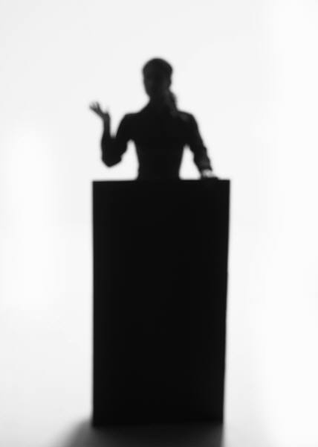
Step 1: “Quotation Marks”
Quotation marks appear around any text that you did not write
They tell the reader that another author (not you) is speaking
Example:
“As soon as children learn to evaluate themselves, some of them become afraid of challenges.”

Slide 16

Step 2: Signal Phrase
Once the original text is in “quotation marks,” add a signal phrase.
A signal phrase indicates who is speaking in the quote.
It improves flow and gives important background information for the reader.
Example:
According to psychologist Dr. Carol Dweck, “as soon as children learn to evaluate themselves, some of them become afraid of challenges.”

Slide 17

Possible Signal phrases
You can use a wide variety of signal phrases. The most common is probably “according to,” but you can also use any verb that means “says.”
For example:
Dr. Carol Dweck states
Dr. Carol Dweck argues
Dr. Carol Dweck emphasizes
Dr. Carol Dweck describes
Dr. Carol Dweck illustrates
Dr. Carol Dweck notes
Dr. Carol Dweck suggests

Slide 18
Step 3: In-Text Citation
After the quote, include the page number in parentheses.
This allows your reader to locate your source and learn more.
Example:
According to psychologist Dr. Carol Dweck, “as soon as children learn to evaluate themselves, some of them become afraid of challenges” (16).
Note the order of the punctuation.

Slide 19
Other possibilities for in-text citation
If you do not name the author in the signal phrase, include his/her name in the in-text citation
Example: (Dweck 16).
If your work does not include page numbers (like many online sources), do not provide a page number
Example: If the author is named in a signal phrase…
John McWhorter describes microaggresions as “quiet, often unintended slights — racist or sexist — that make a person feel underestimated on the basis of their color or gender.”
Example: If the author is not named in a signal phrase…
Microaggressions are “quiet, often unintended slights — racist or sexist — that make a person feel underestimated on the basis of their color or gender” (McWhorter).

Slide 20
Works Cited Page

Slide 21
Works Cited
The final step to properly citing sources in MLA format is a Works Cited page
This page is an alphabetized list of all the sources you used to complete your assignment
It is also a scholarly courtesy because it helps your readers locate the sources you used so they can learn more about your topic

Slide 22
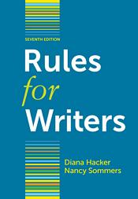
Using a handbook to create a works cited page
A handbook like Rules for Writers is a valuable tool in creating a properly-formatted Works Cited page.
You should be able to find the MLA section of your handbook quickly. Often, the margins of the pages are shaded to help you find them.
The first step to creating a proper citation is to know what type of source you’re using (book, article, website, etc.).
Find that source type in your handbook using the table of contents in the MLA section.
The handbook will guide you through the proper format for citing that type of source.

Slide 23
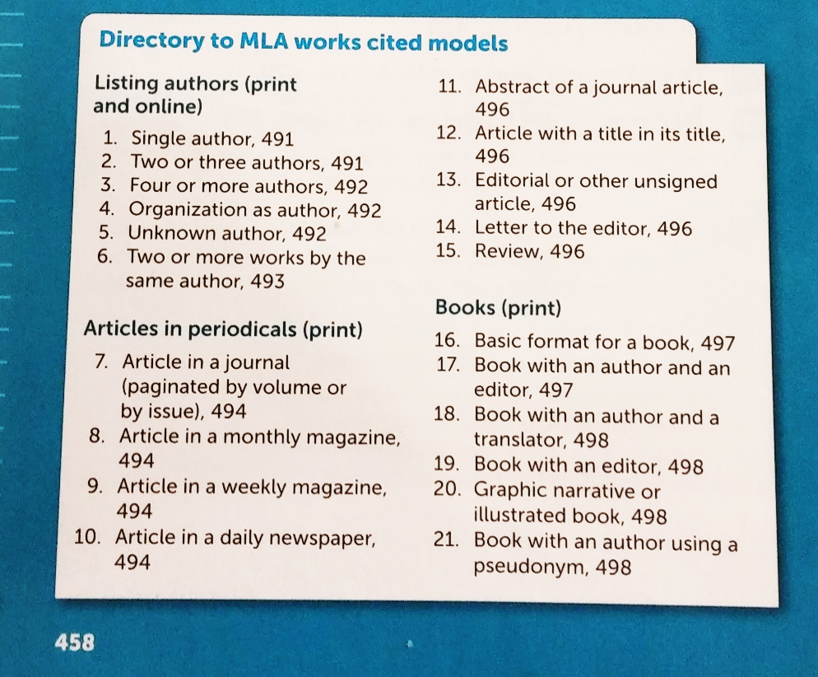
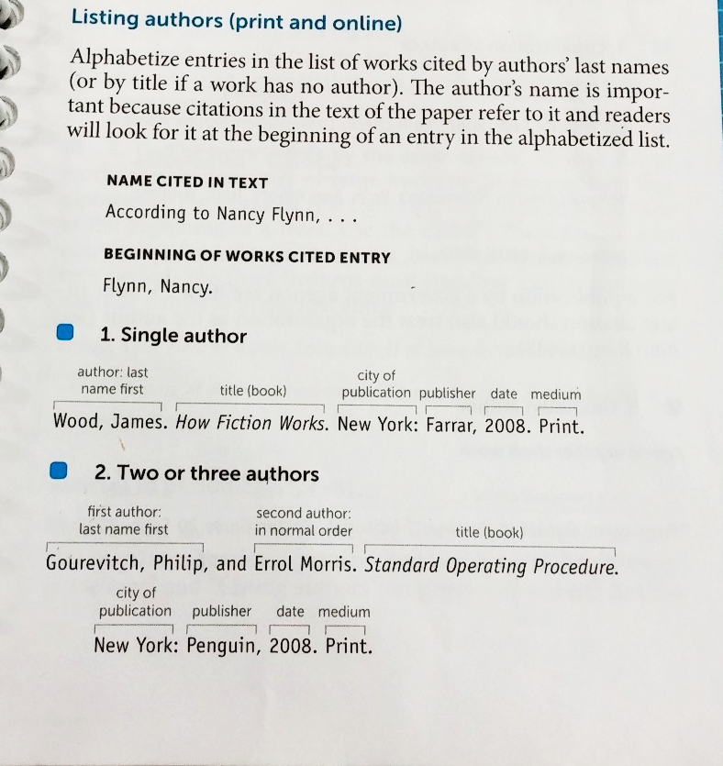
Sample Handbook Pages
Table of Contents
Citing a Book:

Slide 24
Sample Citation: Book with a Single Author
To cite a book with a single author:
Author Last Name, First Name. Book Title. City: Publisher, Year. Medium.
Dweck, Carol. Mindset. New York: Ballantine Books, 2006. Print.

Slide 25
Sample Citation: Work in an anthology
To cite a work in an anthology (like an article or story in a textbook):
Last Name of Article Author, First Name. “Title of Article.” Title of Anthology. Ed. Name of Editor(s) of Anthology. City: Publisher, Date. Pages. Medium.
Steffen, Alex. “On Earth Day.” Envision in Depth. Ed. Christine Alfano and Alyssa O’Brien. Boston: Longman, 2011. 267-271. Print.

Slide 26
Sample Citation: Website
To cite a complete website:
Author Last Name, First Name. Title of Website. Sponsor of Site, Update. Medium. Date of Access.
Positive Psychology Center. Positive Psychology Center. University of Pennsylvania, 2007. Web. 24 March 2014.
Note: The Positive Psychology Center is an organizational author with its own web page. That is why it is listed as both the author and the title.

Slide 27
Sample Citation: Online Article
To cite an online article or other short work from a website:
Author Last Name, First Name. “Title of Article.” Title of Website. Sponsor, Update. Medium. Date of Access.
McWhorter, John. “’Microaggression’ Is the New Racism on Campus.” Time. Time, 21 Mar. 2014. Web. 24 Mar. 2014.

Slide 28
Sample Citation: Online Video
Online videos use the same citation style as online articles.
Author Last Name, First Name. “Video Title.” Title of Website. Sponsor, Update. Medium. Date of Access.
Animalist. “Why do Whales Breach?” YouTube. YouTube, 15 Mar. 2014. Web. 24 Mar. 2014.

Slide 29
Sample Citation: Journal article from online Database
To cite a journal article accessed through one of the library’s databases:
Author Last Name, First Name. “Title of Article.” Journal Title. Volume.Issue (Date): Pages. Database Name. Medium. Date of Access.
Pink, Daniel. “School’s Out.” Reason 33.5 (Oct. 2001): 28-35. ProQuest. Web. 24 March 2014.

Slide 30
To Format Your Works Cited Page
You should still have a header that includes your last name and page number.
Title the page Works Cited; do not use bold, underline, italics, or “quotation marks.”
List all entries in alphabetical order. Do not number entries or use bullet points.
Double space; do not include extra space between entries.
Use hanging indentation (indents all lines after the first line of an entry).

Slide 31
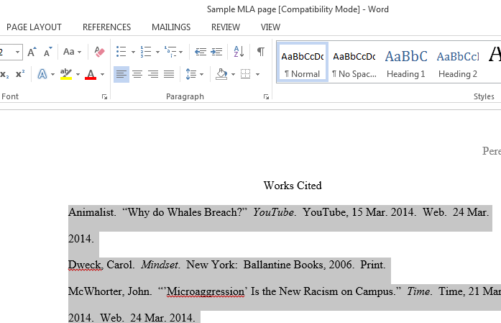
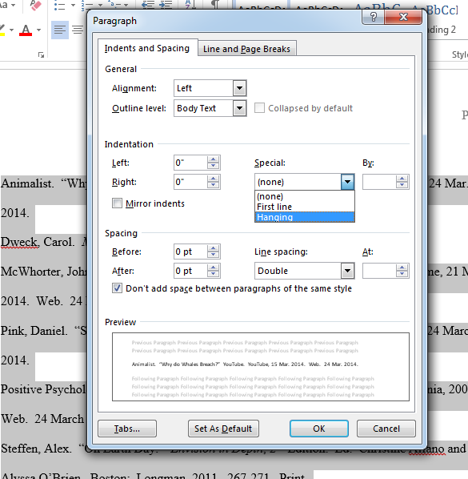
How to do Hanging indentation in word
Highlight the citations.
Click on the box next to Paragraph.
Under Indentation, look for a box labeled Special.
Select Hanging Indentation and click OK.

Slide 32
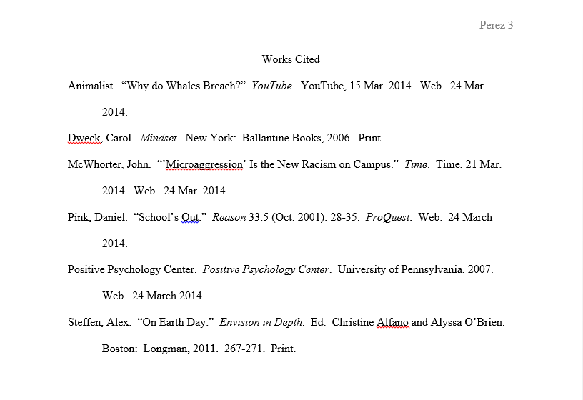
Sample Works Cited Page

Slide 33

Still Confused?
If you’re still confused, ask for help! You can use your resources:
TLC Tutors
College of the Canyons Library
Your instructor
And don’t forget to refer to your handbook!

Slide 34

Cautions
MLA format does have revisions and updates every few years. Make sure you’re using the most recent version.
Avoid automatic citation generators like easybib.com. They sometimes make errors in your citation.

Slide 35

If you liked this lesson and would like more information, consider attending:
MLA 2
Online Research
Proofreading
Why should you come back?
Students completing Supplemental Learning Activities had a 10% higher success rate across the disciplines, a 21% higher success rate in Math, and a 49% higher success rate in English courses.

